Slide 1
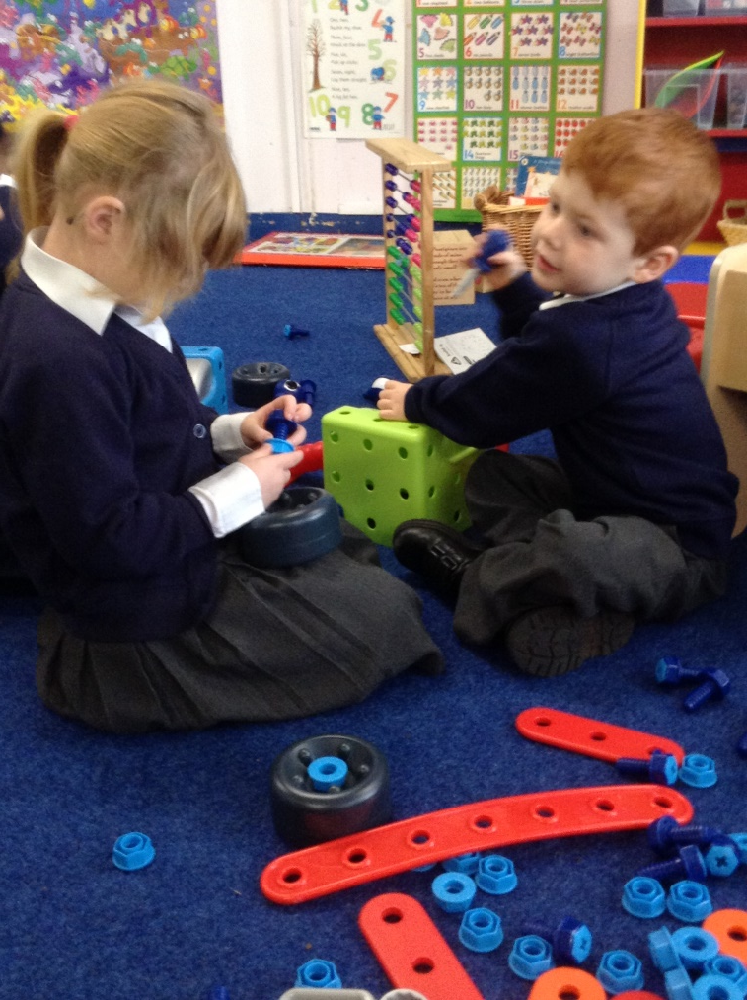

Welcome to Reception

Slide 2
The Foundation Stage Curriculum
What is the Foundation Stage?
The Foundation Stage focuses on the distinct needs of
children aged three to five until the end of the reception year.
The Foundation Stage has its own curriculum which
emphasises learning based on play and experiences.
It is a broad, balanced and purposeful curriculum, delivered through planned play activities to help ensure all children have the opportunity to reach their full potential and experience the best possible start to their education.
Notes:
The children line up on the Windsor Road playground.
Mrs Jordan’s children line up at the white spot
Mrs Pemble’s line up at the yellow spot

Slide 3
The Seven Areas of Learning and
Development:
Personal, Social and Emotional Development
Communication and Language
Mathematics
Literacy
Understanding of the World
Expressive Arts and Design
Physical Development

Slide 4
Personal, Social and Emotional
Development
Successful Personal, Social and Emotional Development is critical for very young children in all aspects of their lives and gives them the best opportunity for success in all other areas of learning.
We believe that it is crucial that we provide the experiences and support to enable children to develop a positive sense of themselves.
This might be delivered through;
Name recognition
Reward charts
Offering choice and fostering independence
Circle time
Recognising and celebrating personal achievements
Modelling a positive, nurturing and supportive environment

Slide 5
Communication and Language
Communication and Language depend on learning and being competent in a number of key skills, together with having the confidence, opportunity, encouragement, support and disposition to use them. This area of learning includes communication, speaking and listening in different situations and for different purposes, and using past, present and future forms accurately.
This might be delivered through;
Opportunities for purposeful talk
Role Play
Circle time
Listening corner

Slide 6
Physical Development
Physical development in the Foundation Stage is about improving skills of co-ordination, control, manipulation and movement (Fine and Gross motor skills).Physical development has two other very important aspects. It helps children gain confidence in what they can do and enables them to feel the positive benefits of being healthy and active.
This might be delivered through;
PE sessions - gym, dance, games
Exploring the outside area
Pencil control
Developing gross and fine motor skills
Talking about diet and ways to keep healthy
Supporting children to manage their own basic hygiene

Slide 7
Literacy
Reading- children read and understand simple sentences.
They use phonic knowledge to decode regular words and read them aloud. Children enjoy and recognise a wide range of texts, including, signs labels, instructions, stories and information books.
Writing- Children use their phonic knowledge to write words which match their spoken sounds. Children write for a variety of purposes.
We have lots of fun in PE

Slide 8
Mathematics
Mathematical development depends on becoming confident and competent in learning and using key skills. This area of learning includes counting, sorting, matching, seeking patterns, making connections, recognising relationships and working with numbers, shapes, space and measures. Mathematical understanding should be developed through stories, songs, games and imaginative play, so that children can enjoy using and experimenting with numbers. This includes numbers with two digits.
This might be delivered through;
Play dough, making numbers, making shapes
Mathematical games
Shape pictures
Number puzzles
Problem solving
Application through ‘everyday’ situations
Role play, timing, measuring, recording, counting and using mathematical language
Mathematical challenges, including doubling, halving and sharing.
Notes:
For our topic people who help us we invite parents and professionals in to talk about their jobs. In the past we have had a nurse, police man , fire men and the children especially like the pilot.

Slide 9
Understanding the World
In Understanding of the World children are developing the crucial knowledge, skills and understanding that help them to make sense of the world. It includes helping children develop the skills of observing, predicting, exploring, investigating, interpreting, discussing, decision-making and using tools and materials appropriately.
This might be delivered through;
Real experiences
Technology and its uses
Role play
Map work through stories
Exploring the school and local environment
Learning about ourselves, how we have grown and changes
Looking at similarities and differences

Slide 10
Expressive Arts and Design
Expressive Arts and Design is fundamental to successful learning. Being creative enables children to make connections between one area of learning and another so extend their understanding. This area of learning includes art, design and technology, music, dance, role play and imaginative play.
This might be delivered through;
Songs
Using instruments and making music
Painting, collage, clay, junk modelling, chalking...
Construction and junk modelling
Drama and role play

Slide 11
Reception Baseline
On entry to Bournebrook CofE Primary School, Reception children are being assessed using the Early Excellence Baseline. The Early Excellence Baseline (EExBA) does not include any tasks or tests and will not disrupt children in their everyday learning in Reception. This is carried out through observation and discussion with the children during their play and learning. I will use this professional knowledge to make a series of judgements about each child based on a clear set of assessment criteria.

Slide 12
Reception Baseline
Giving the children a baseline upon entry enables me to tailor the learning to the needs of the children and enables the school leadership team to track the progress that they make throughout their school life.
Your child will be assessed within the first six weeks of starting school. I will decide when they are ready for the assessment. It only takes place once they are settled and confident in their new class.

Slide 13
Reception Baseline
Your child’s baseline assessment score will be used by school to assess his progress between starting reception from four years and when he leaves primary school at 11 years old. The results will be sent to the Department for Education (DfE) so that his score can be compared with other children of a similar age, starting school all over the country. The DfE will also compare progress made in all schools.

Slide 14


On Line Learning Journal
Security

Slide 15
The Bournebrook Way
We Respect the Bournebrook Way
Where we Grow and Flourish Cradled by Christian Values

Slide 16
My Way
My Way homework is given in Reception and KS1. The children are given a title or some information linked to learning which has been taking place in school. The children will then ‘research’ the area/title they have been given and then choose how they will present their work.
Children can draw pictures, write sentences, take pictures, cut out pictures from magazines and make things.
Topics have included- My favourite Julia Donaldson story, an African country and being a Spring Detective.

